Slide 1

DATA STRUCTURES AND ALGORITHMS (113215)
Dr. Owais Hussain

Slide 2

Agenda
Introduction
Data organization
Data structures and their operations
Algorithms
Space and Time complexity
Asymptotic notations
Real life example

Slide 3
Sample 2
Introduction
Understanding data structures is the heart of all data keeping strategies in digital and real world.
Data structures can help you in managing your TODO lists.
Data structures can also help you win battles, like the battle of Talafgar in 1805.
In fact, they can help you win wars, like Alan Turing’s cracking of Enigma code.
Notes:
British royal navy documented information about each ship's crew, including their roles, experience, and skill levels which enabled them to assess the strengths and weaknesses of their own fleet and strategically assign skilled crew members to appropriate positions. They won against Napoleon’s mighty despite being outnumbered.
During World War II, the Allies' successful decryption of the German Enigma machine's encoded messages was a critical factor in their victory. The decryption effort, led by British mathematician Alan Turing, involved the use of sophisticated data structures and algorithms to crack the Enigma codes. By extracting vital intelligence from intercepted communications, the Allies gained a significant advantage in strategic decision-making, enabling them to thwart German military operations.

Slide 4
Sample 2
Data Organization
Real story of NADRA’s first database.
What would you have done if you were in charge?
We organize data for:
Easy access
Maintain integrity
Faster reporting
Scalability
Sharing
Security
Notes:
NADRA computerized their entire paperwork in text files, but there was no sequence in files. Each row had a different pattern of data entry, thus the entire DB was useless.

Slide 5
Sample 2
Data Structures and their Operations
Data structure (Data + Structure) is simply a logical or mathematical arrangement used to keep data. For example, in a library the books can be organized in many structures:
Random: any book can be found anywhere.
Sorted: all books are arranged by their title
Grouped: books are kept in sections, but within sections they are put randomly.
Grouped and sorted: books are kept in sections, and in each section, they are sorted by their titles.
Similarly, in computer memory, we can keep data in different structures.

Slide 6
Sample 2
Data Structures and their Operations
The most frequent operations we perform in any data structure are:
Insert: add new data to existing collection.
Remove: remove an existing data point from the collection.
Search/Find/Retrieve: find a data point in a collection.
Get size: count the number of data points in a collection.
Split: divide a collection into two or more subsets.
Merge: combine multiple collections into a superset.
Sort: rearrange a collection in ascending or descending order.
This sound much same as the operations we generally perform in a database system. That’s because each database is a data structure.

Slide 7
Sample 2
Data Structures and their Operations
There are some advanced operations performed in a data structure:
Sort: arrange all the data by some value
Append (or Add After): insert data at the end of collection.
Prepend (or Add Before): insert data at the start of collection.
Empty/Clear: remove all data from a collection.
Update: change the value of an item in the collection.
Pop: get top value and remove from the collection.
Search: get one or more elements in a collection that match a criteria.
Different data structures may use different terms, but the operation remains the same.

Slide 8
Sample 2
Data Structures and their Operations
Data Structures can be classified into Linear and Non-linear.
Linear data structures are arranged sequentially.
Static: have fixed memory size
Dynamic: have flexible memory
Non-linear data structures do not keep all elements sequentially.
Data Structures
Linear
Static
Dynamic
Non-linear
Tree
Arrays
Linked List
Stack
Queue
Graph

Slide 9
Sample 2
Algorithms
An algorithm is a way to express logic. It can be in any language and use any symbols. It can be in plain English as well.
A set of instructions with a clear meaning that can be performed within a finite amount of time to solve a problem. It requires an input, a logic to perform some operations on that input and an output.
A pseudocode is an algorithm written in formal way using standard symbols.
A computer program is written in a formal language to represent an algorithm. Computers are quite inflexible compared to human mind, so programs need to contain some more details than algorithms.

Slide 10
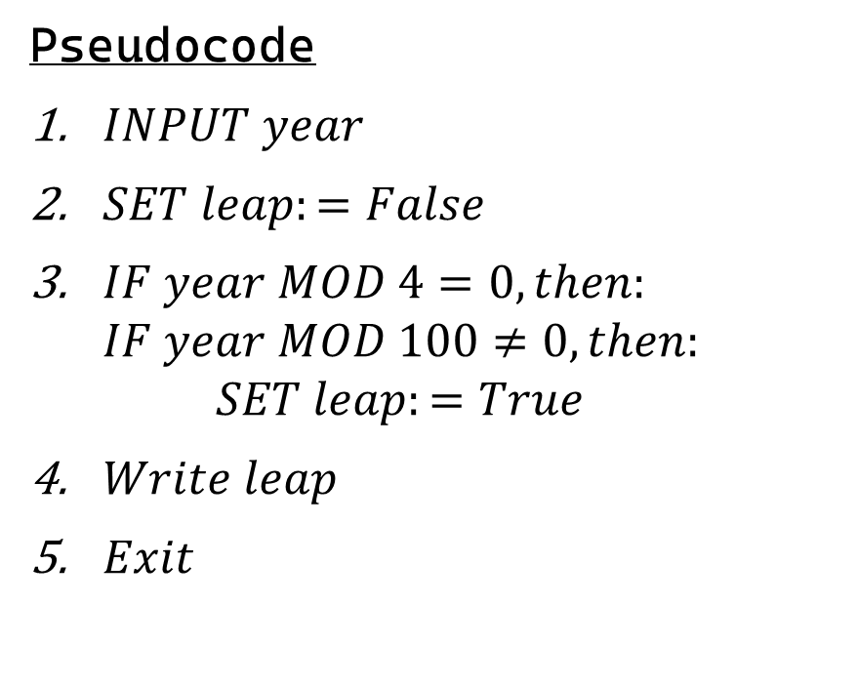
Sample 2
Algorithms: Example
Find out whether a year is a leap year or not
Algorithm
Input a year
Divide it by 4 and 100
If the first remainder is 0 and second remainder is not 0, then the year is leap. Otherwise not.
Pseudocode
$INPUT year$
$SET leap:=False$
$IF year MOD 4=0, then:$
$$IF year MOD 100≠0,then:$$
$$SET leap:=True$$
$Write leap$
$Exit$

Slide 11
Sample 2
Algorithms: Exercise
Write an algorithm which inputs the number of students in your class and tells whether they can be separated into 2 equal groups or not.
Present this algorithm in Pseudocode form.
Write a console program to execute this algorithm.

Slide 12
Sample 2
Space and Time Complexity
Space complexity means how much memory is required to solve a given problem.
Space complexity is measured in computer storage units (bytes, etc.)
Time complexity means how much time is required to solve a given problem.
Time complexity is measured usually in seconds/minutes, however for simplicity, we often use the term “unit of time”.
Both are used to measure the efficiency of an algorithm. However, since memory is cheaper, we mainly focus on time complexity.

Slide 13
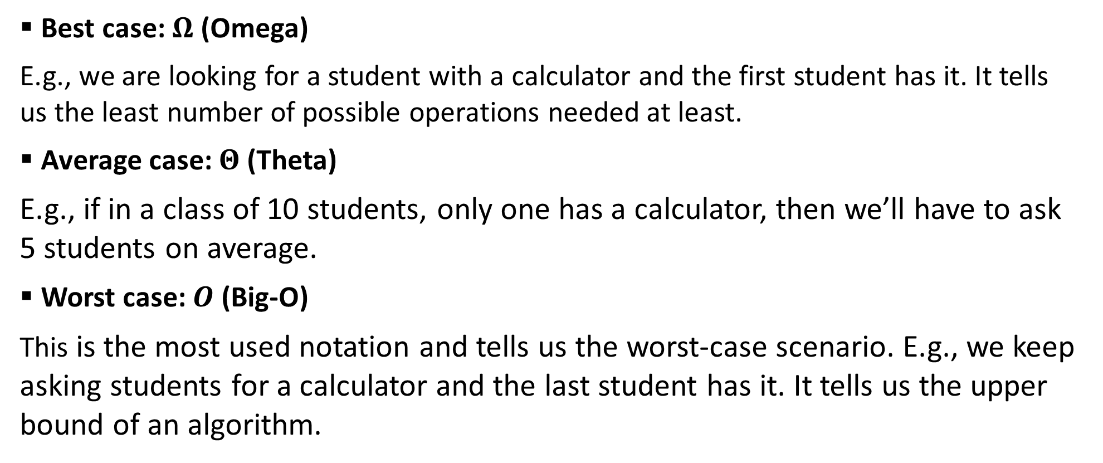
Sample 2
Asymptotic Notations
Best case: $Ω$ (Omega)
E.g., we are looking for a student with a calculator and the first student has it. It tells us the least number of possible operations needed at least.
Average case: $Θ$ (Theta)
E.g., if in a class of 10 students, only one has a calculator, then we’ll have to ask 5 students on average.
Worst case: $O$ (Big-O)
This is the most used notation and tells us the worst-case scenario. E.g., we keep asking students for a calculator and the last student has it. It tells us the upper bound of an algorithm.

Slide 14
Sample 2
Real life Example
All examples covered in this course will be related to the following scenario:
The College of Computing and Information Sciences offers courses in all 3 campuses of KIET. The students from various programs including CS and SE are identified by a unique SID. Their courses have unique codes and credit hours. Each student has a grade sheet containing his/her records of courses enrolled in and marks acquired, which aggregate to define their grades and a Cumulative GPA.
Our objective is to design a system to manage the students’ information, which can insert, delete, search and present their data in an efficient manner.

Slide 15
Sample 2
Real life Example
Now that you have the example, answer the following:
What will be the data fields for this system?
What will be the data types for each field?
Which of the fields should be used to uniquely identify a student?
Which fields should be used for aggregate operations?

Slide 16
Sample 2
Exercise
An algorithm inputs CGPA of students in your class. Suppose that the algorithm take 1ms to compare two numbers, then what will be the worst time complexity of this algorithm if we ask it to find out highest CGPA in your class?

Slide 17
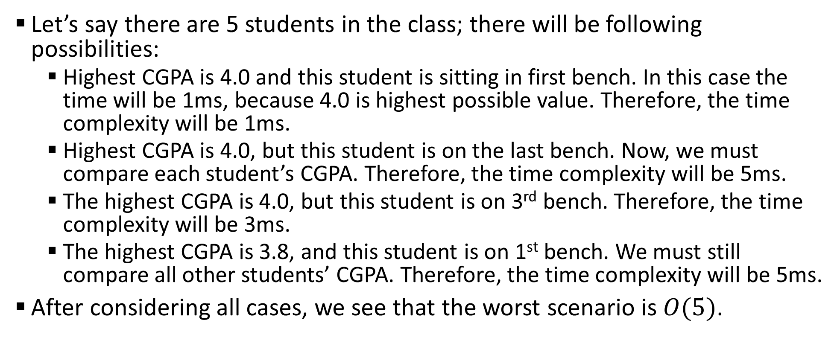
Sample 2
Exercise
Let’s say there are 5 students in the class; there will be following possibilities:
Highest CGPA is 4.0 and this student is sitting in first bench. In this case the time will be 1ms, because 4.0 is highest possible value. Therefore, the time complexity will be 1ms.
Highest CGPA is 4.0, but this student is on the last bench. Now, we must compare each student’s CGPA. Therefore, the time complexity will be 5ms.
The highest CGPA is 4.0, but this student is on 3rd bench. Therefore, the time complexity will be 3ms.
The highest CGPA is 3.8, and this student is on 1st bench. We must still compare all other students’ CGPA. Therefore, the time complexity will be 5ms.
After considering all cases, we see that the worst scenario is $O(5)$.

Slide 18
Sample 2
Assignment 1
Write an algorithm and its pseudocode to measure the average number of credit hours you have earned per semester.
Assuming each statement in your program takes 2ms to execute, what will be the best, average and worst time complexity?
Submit your solution on LMS.

Slide 19
Sample 2
Pre-requisites Reading
Refer to Chapter 2 of your Textbook (Theory and Problems of Data Structures by S. Lipschutz) and revise:
Floor and Ceiling function
Modulus function
Round and Absolute functions
Factorial
Permutation and combination functions
Flow charts and algorithmic notations

Slide 20



THANK YOU
Owais Hussain
+92 345-3174270
owais.hussain@kiet.edu.pk
https://www.researchgate.net/profile/Owais-Hussain-3

